Slide 1


Amplifier Additive¹ Phase Modulation Noise Characterization and Testing and Theoretical Discussion of White and Flicker Noise Processes in both Small and Large Signal Regions of Operation* Mini-Circuits
Low-Level Radio Frequency (LLRF) Workshop 2025
Let’s address these common questions:
What is it?
How is it measured?
How is it specified?
Test Set Description
Additive Phase Noise Theory
Small Signal Behavior
Large Signal Behavior
AM-to-PM Distortion Influence
Broadband and Cascade Design Tradeoffs
Joseph L. Merenda
V.P. of Engineering
JoeM@minicircuits.com
Id#107
*Class A, AB Only. ¹:flicker and white

Slide 2
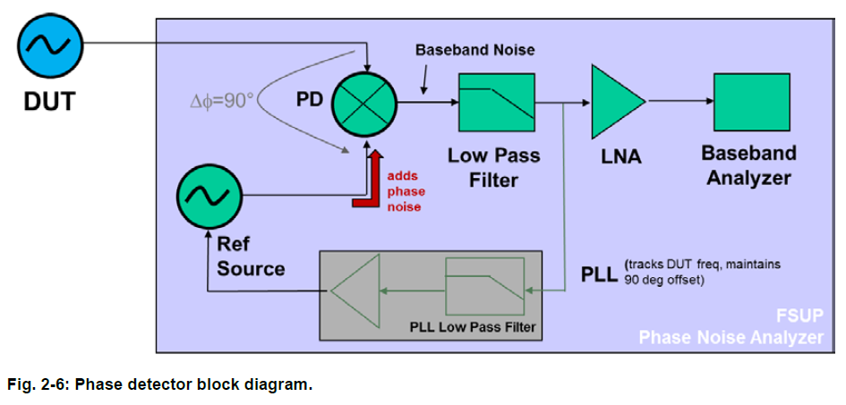
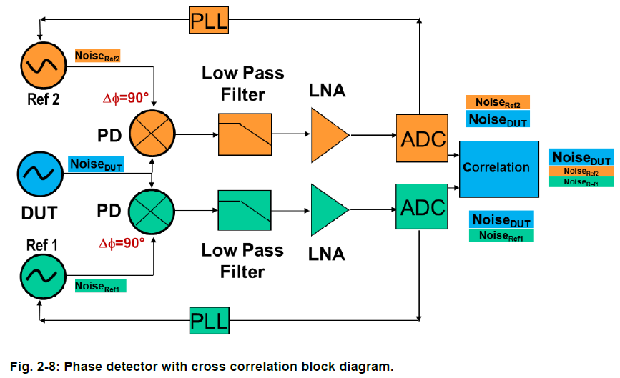
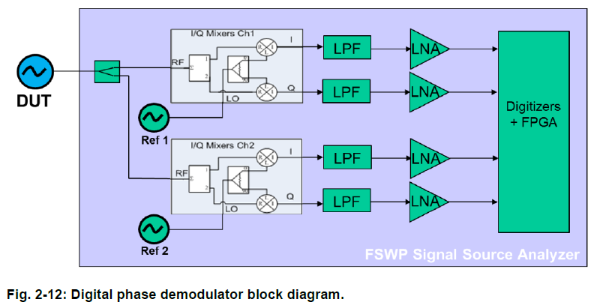
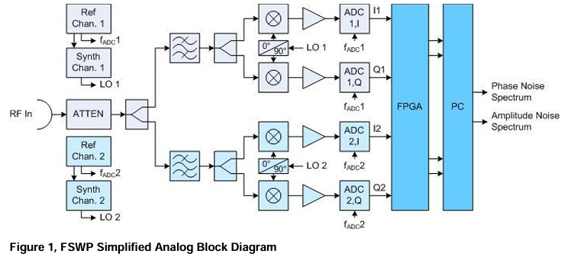
Cancel un-correlated noise not common to Channels 1 and 2.
RE: AM Noise, IM: PM Noise
R&S FSWP:
What’s Inside?
All images courtesy of Rohde & Schwarz GmbH & Co. KG

Slide 3
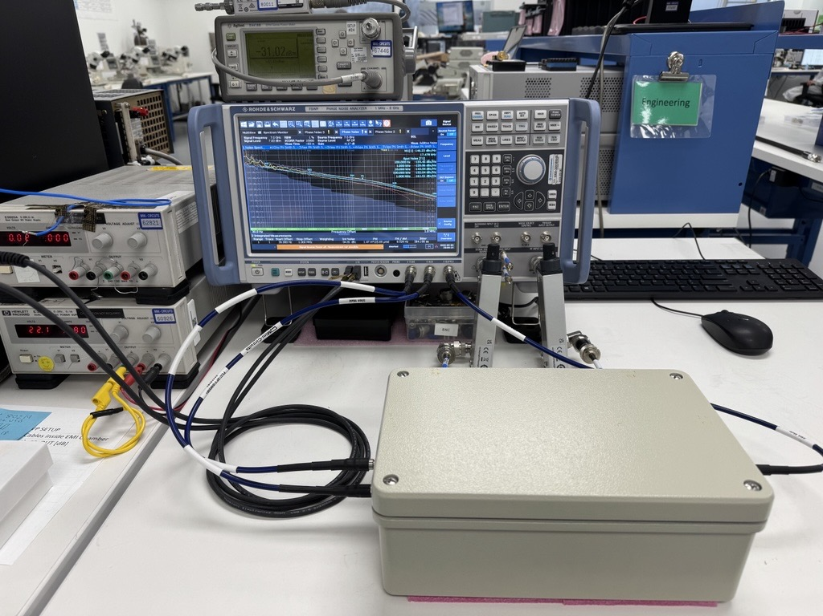
Class 100k clean room
Filtered AC power
FSWP Analyzer
Short RF I/O Cables
EMI Enclosure
Shielded DC Cables (3)
Vibration isolated table
Test Lab

Slide 4
For best results:
APM/AAM measurements must be performed with short, well matched, low loss, shielded and phase stable RF cables and well shielded DC cables.
Care should be taken when torquing all cable connectors to ensure they are tight and that any mechanical (torsional) stress in the cables is eliminated.
The DUT (and in certain instances the test equipment itself) must be placed inside a suitable EMI shielded enclosure.
It is also very important that the DUT and test equipment be well isolated from any external, mechanical vibration and AC line noise.
The ambient, DUT and test equipment temperatures be stable and held constant during the measurement.
Be sure not to disturb or touch anything during the measurement process!
APM: Additive Phase Modulation Noise
AAM: Additive Amplitude Modulation Noise

Slide 5
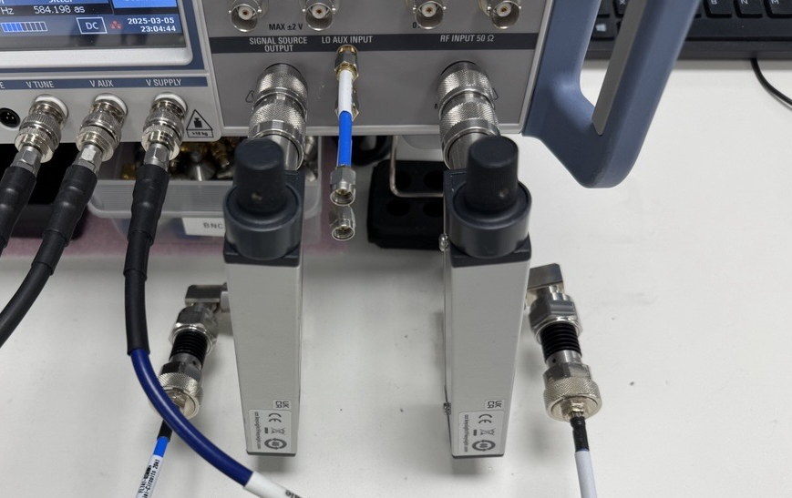
Signal Source Output
(To DUT)
Fc, Po
RF Input
(From DUT)
Input Step Attenuator
(To DUT)
Output Step Attenuator
(From DUT)
Input Fixed Pad
(To DUT)
Output Fixed Pad
(From DUT)
Short RF I/O Cables
Test Lab

Slide 6
For our analyzer:
Fixing the signal source power at the optimum level and using an external, mechanical step attenuator and fixed pad on the signal source output port to set the power level into the DUT, provides more consistent APM performance compared to that achieved using the analyzer’s internal attenuator.
We use a second mechanical step attenuator and fixed pad after the DUT, on the input to the analyzer’s RF input port and adjust the attenuation to maintain a constant signal power into the analyzer’s RF input port.
This method provides for enhanced accuracy and repeatability and ensures that maximum input power levels are never exceeded.
Ideally, the RF input port signal power is adjusted and maintained at a fixed power level, between ≈+7 to +13 dBm for all input attenuator steps.

Slide 7
Measurement Parameters include the following:
• Carrier Frequency: As required (0.1-8 GHz, typical).
• Signal Source Output power level: +13 dBm, or max allowable.
• Measurement: Additive Noise.
• Offset Frequency: 100 Hz to 1 MHz (as required).
• Spot Noise: 100, 1,000, 10,000, 100,000, 1,000,000 Hz.
• Resolution Bandwidth: 1%.
• Cross-Correlation Factor: 100 to 10,000 (as required).
• Cross-Correlation Threshold: 15 dB.
• Spurious Threshold: 6 dB.
• Sweep Average Count: 0.
• Smoothing Value: 1%.
• RF Input: Fixed between +7 dBm to +13 dBm.
Key Settings

Slide 8
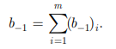
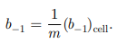
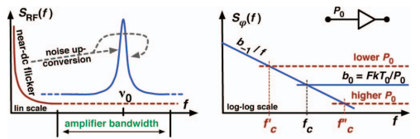
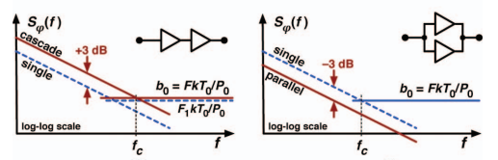
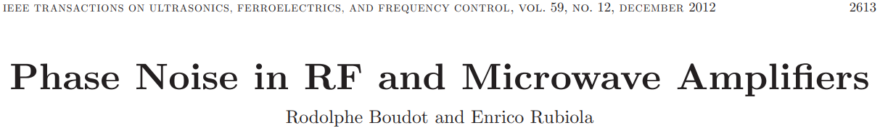
What is Amplifier Additive Phase Noise?
Flicker(parametric) White(additive)
PSD of Random Phase ф(t) = S_{ф} (f) = b₀ + b₋₁/f [rad^2/Hz] = FkTo/Pin + b₋₁/f [rad^2/Hz]
and L(f) [rad^2/Hz] = ½ S_{ф} (f) [rad^2/Hz]; L(f) [dBc/Hz] = 10*Log₁₀(S_{ф} (f)) - 3dB
Single Device Small Signal Operation
(L(f)= ½ S_{ф} (f) for delta ф_peak <~0.2 rad)
[2]

Slide 9
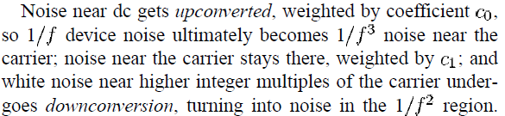
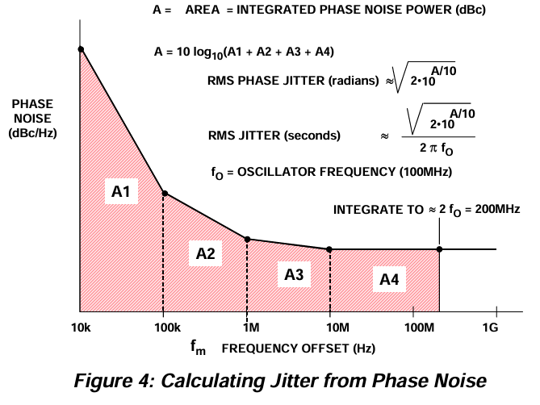
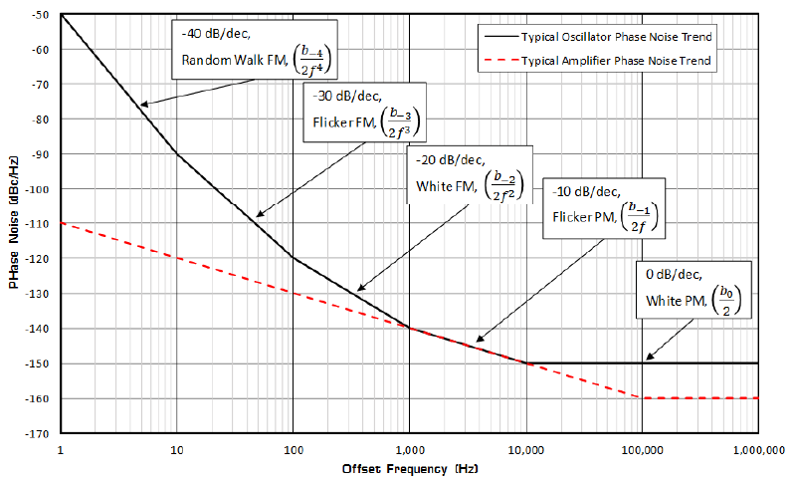
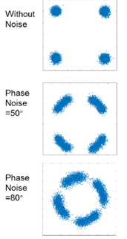
Why do we care?
“Time fluctuations are critical in the RF cavities of particle accelerators where they cause intensity loss or energy loss in the beam.” F. Tecker, H. Damereau.
BER
Converting Oscillator Phase Noise to Time Jitter
by Walt Kester
Google search
[2]
Amplifier additive 1/f and White noise degrades oscillator noise, Jitter and cascade S/N ratio

Slide 10
What is White Noise?
P_{out}
MDS: Minimum Discernable Signal at Input
MDS = FkT₀B. B=1Hz, T₀=290K, k=1.38x10-23W*S/K
b₀ = FkT₀/P₀=MDS/P₀ [rad^2/Hz]
[2]
G, F
MDS_{out}: Minimum Discernable Signal at Output
MDS_{out} = MDS*G = FkT₀G, B=1 Hz
b_{0_out} = MDS_{out} /P_{out} = FkT₀G/P_{out} => FkT₀G/P_{sat}
b_{0_out} = b₀ , P_{out} = G P₀
Cascade: Ftot=F1+(F2-1)/G1+(F3-1)/G1G2+--- => maximize G1
Typ. Rule of Thumb
(does it hold?)
Cascade!!
Optimum APM:
Minimize Gain and Noise Figure
Maximize Pout (Psat)
Good Luck!!

Slide 11
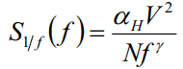
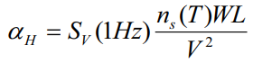
“Flicker noise in AlGaAs/GaAs of high electron
mobility heterostructure field-effect transistor at
cryogenic temperature” [11]
What is Flicker or 1/f Noise?
For HEMT Devices*:
For HBT Devices:
High N⁺*W*L⁻ and
Low I_{_EQ}
High R_{_E (un-bypassed)}
High Vcb
Low Cbe, Cce
Low G_dc
DC Filtering
Passives
HBT “always” better than HEMT?
n_{s}(T): electron gas density
N: number of electrons
(by Hooge)
Also see Dr. Ali Hajimiri
Flicker noise with 1/f power law (~Size of Event/Number of Events) observed in almost all electronic materials
Also observed in mechanical, biological, geological, economic and musical systems
How is it generated? Several theories exist.
Fluctuations of charge carriers due to trapping in surface states
Fluctuations in conductivity due to fluctuations in bulk mobility*
Amplifiers: Dependent upon DC current and voltage, device type, process node size, power density,
fluctuations in I/O impedance and insertion gain and phase,
I/O Impedance matching criteria, input power and carrier frequency.

Slide 12
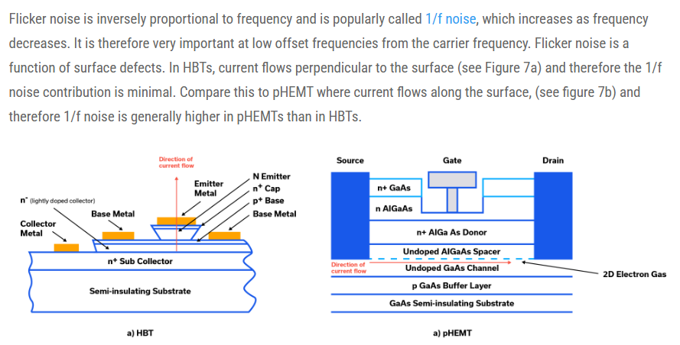
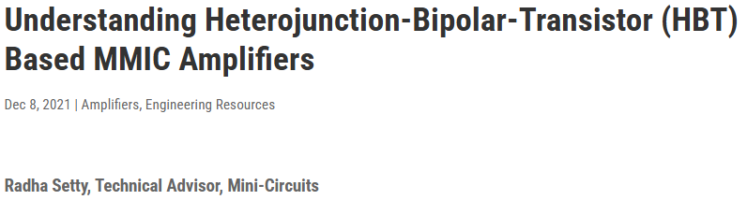
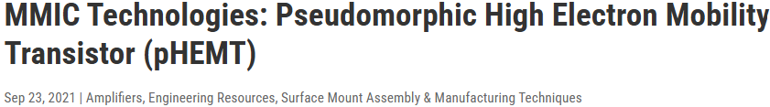
What is Flicker or 1/f Noise?
HBT “always” better than HEMT?
Trap density increases as Lg decreases which increases 1/f noise

Slide 13
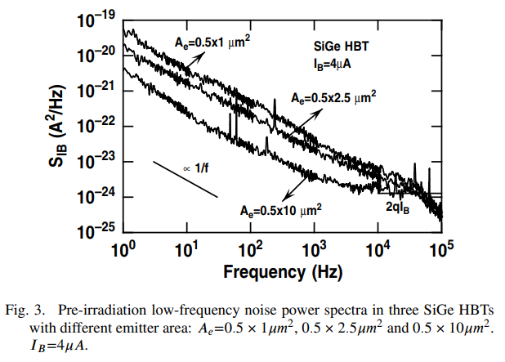
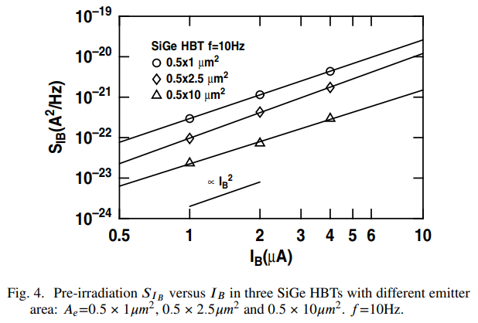
What is Flicker or 1/f Noise?
Ae=We*Le*N
0.5x(0.50x2)
0.5x(1.25x2)
0.5x(5.00x2)
Amplifiers: Dependent upon DC current and voltage, device type, process node size and power density
Fluctuations in impedance and insertion gain and phase. “1/f Noise in Proton Irradiated SiGe HBTs” [10]

Slide 14
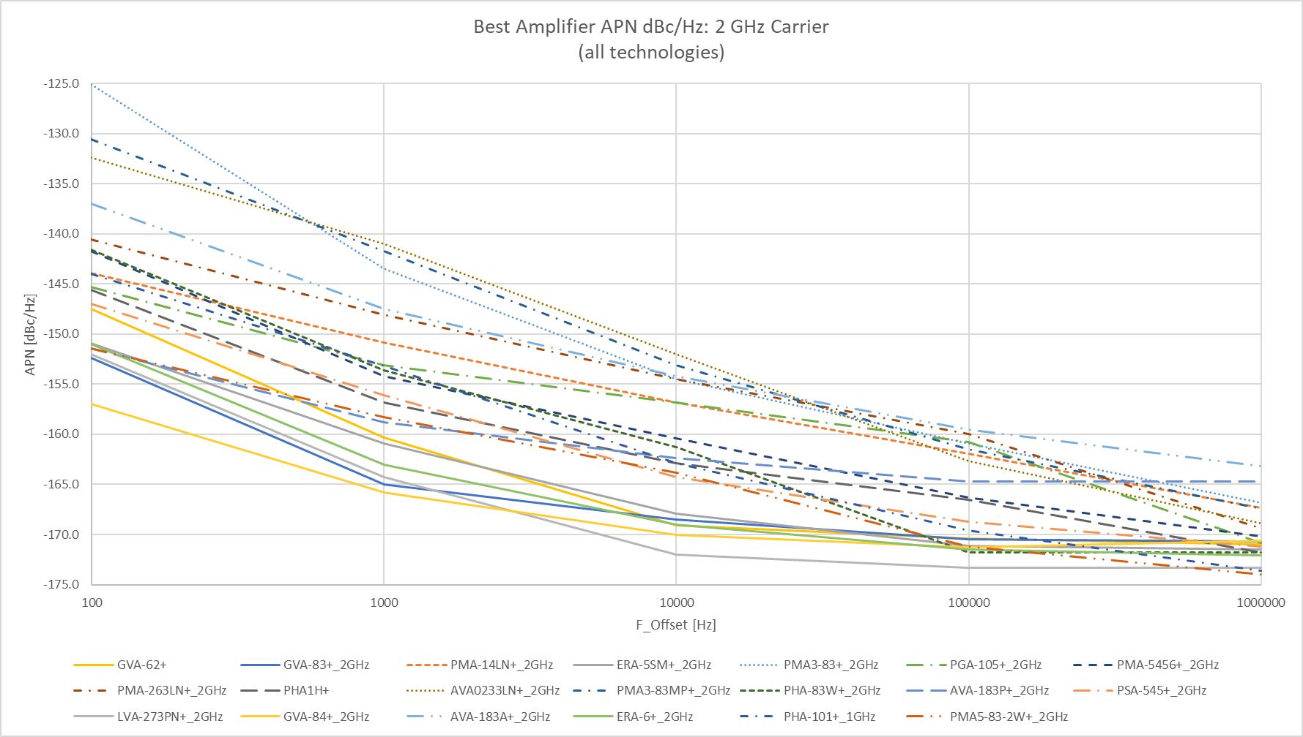
HBT “always” better than HEMT
Trap density increases as Lg decreases which increases 1/f noise
HBT “always” better than HEMT?
Lg=0.15um
Lg=0.25um
For pHEMTs:
~Increasing Lg
0.15um<Lg<0.5um
(45GHz>Fo>50MHz)
dashed: pHEMT
Solid: HBT
For HBTs:
We=2um
(27GHz>Fo>DC)
Lg=0.5um

Slide 15
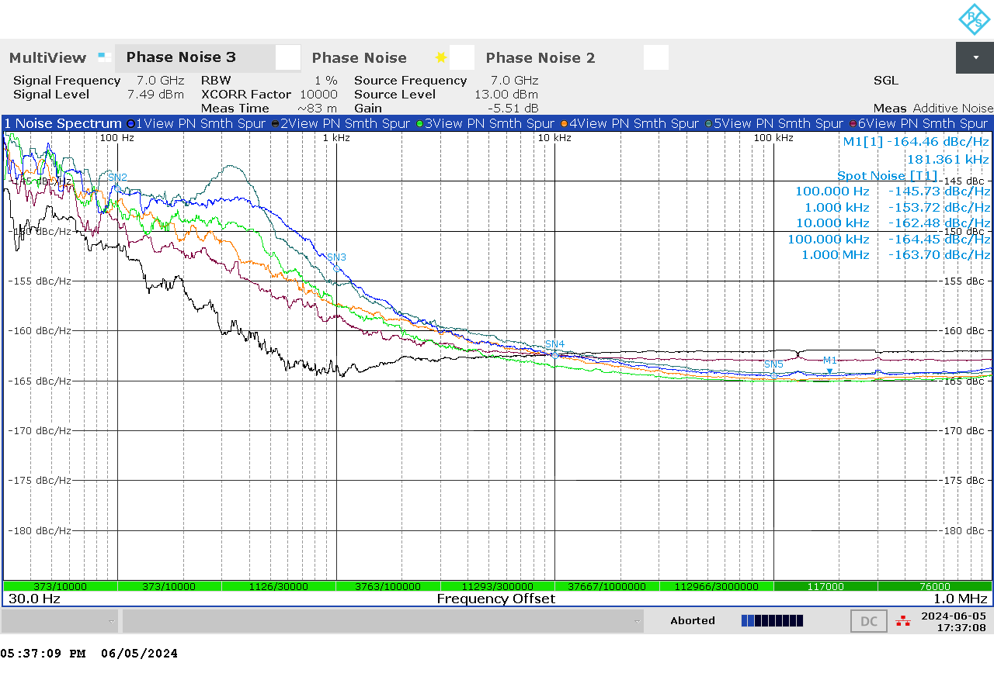
Let’s make some measurements!
Non-DUT related, will discuss next.
How “Low” is Low Power?
L(f) [dBc/Hz] = -177 [dBm/Hz] +NF [dB] – Pin [dBm]
(valid for small signal operation)
Noise is Additive
LVA-273PN+ APM Performance at 2, 3, 4, 5, 6, and 7 GHz Carrier Frequencies. Pin=-7dBm.
(BLK:2GHz, RED:3GHz, GRAY:4GHz, ORANGE:5GHz, GREEN:6GHz, BLUE:7GHz)
(HBT)

Slide 16
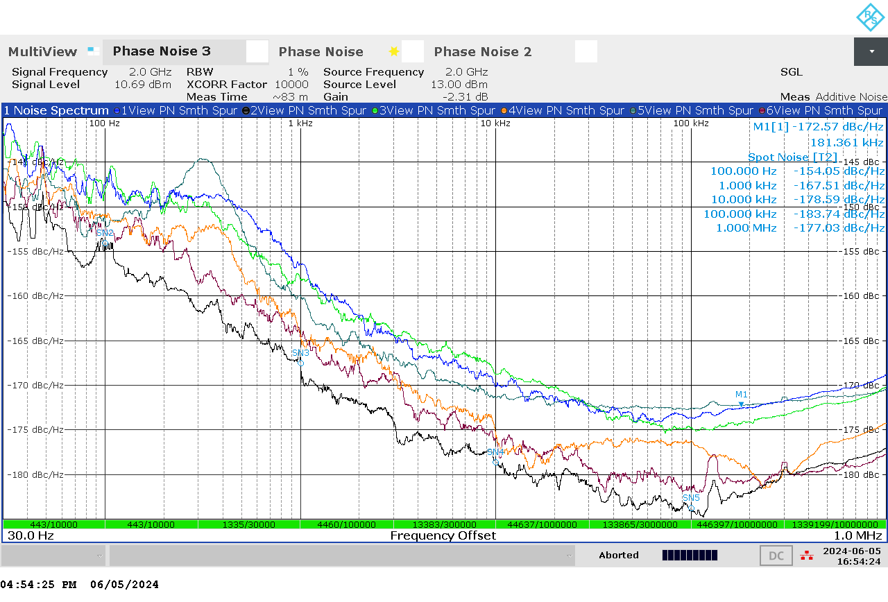
Let’s make some measurements!
Non-DUT related. Adjust source power.
How “High” is High Power?
Increasing F_Carrier
Phase Length
(de-correlation)
Non-DUT related.
Use short RF cables.
Cross-Spectral Collapse?
Test Set through path APM performance at 2, 3, 4, 5, 6, and 7 GHz carrier frequencies
(BLK:2GHz, RED:3GHz, GRAY:4GHz, ORANGE:5GHz, GREEN:6GHz, BLUE:7GHz)
-177dBm/Hz-13dBm=-190dBc/Hz

Slide 17
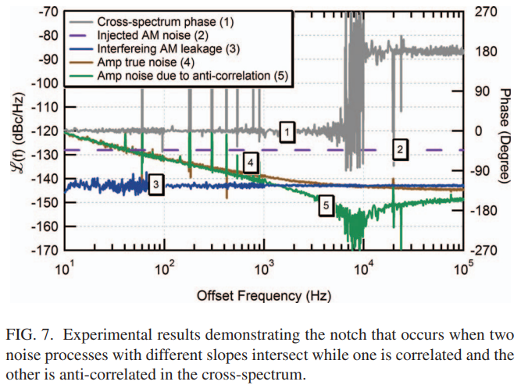
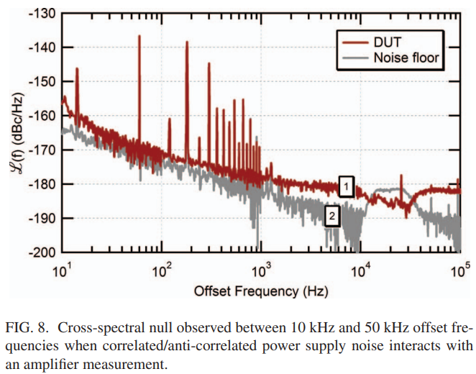
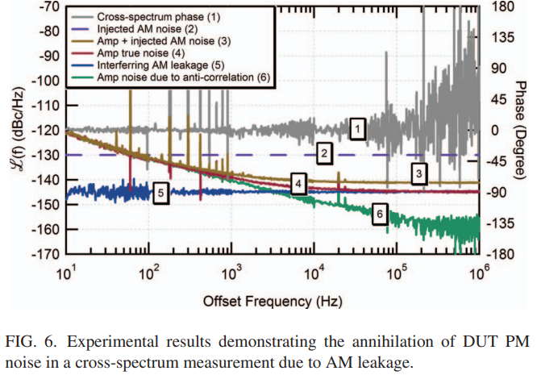
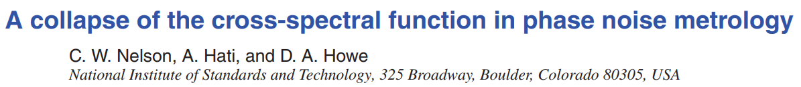
AM/PM Noise Cancellation
Anti-Correlated Supply noise
Anti-Correlated AM noise
Examples of Cross-Spectral Collapse
Cross Correlation: Cancel un-correlated noise not common to Channels 1 and 2.

Slide 18
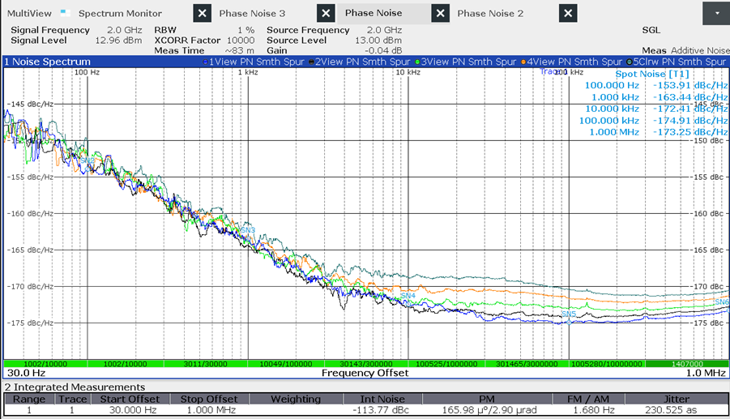
Small Signal Operation
1/f Insensitive to Pin (SS)
Increasing Pin (SS)
L(f) [dBc/Hz] = -177 [dBm/Hz] +NF [dB] – Pin [dBm]
(valid for small signal operation)
Noise is Additive
LVA-273PN+ small signal APM vs. offset frequency at various input powers from:
P_Opt – 4 dB (gray-top trace) to P_Opt (blue-bottom trace), 1dB steps.
(HBT)

Slide 19
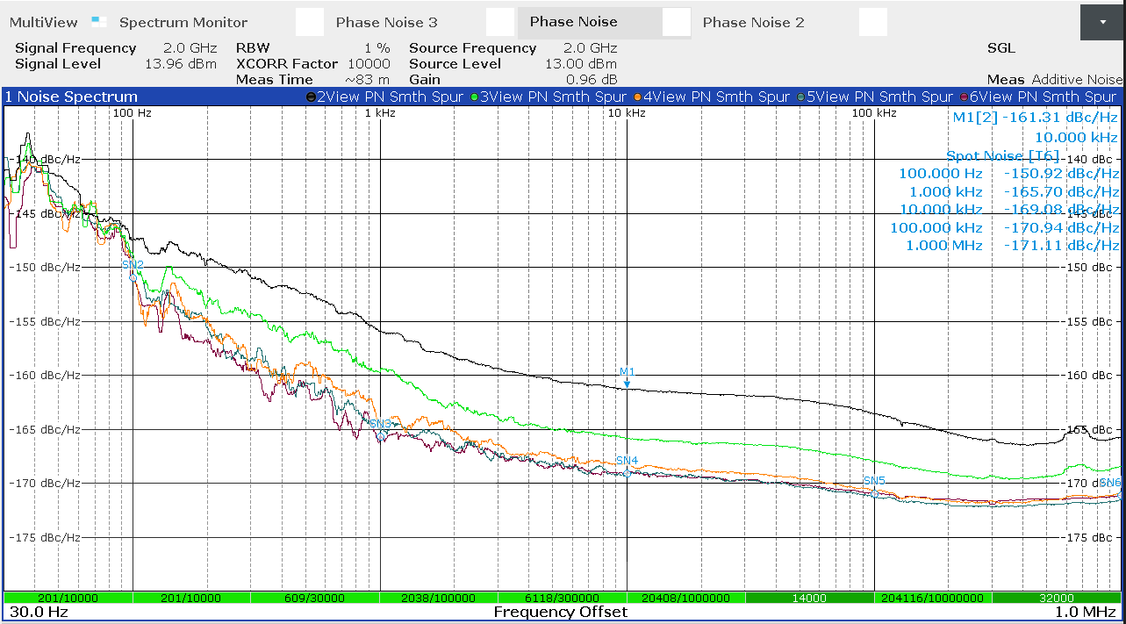
Large Signal Operation
1/f Sensitive to Pin (LS)
Increasing Pin (LS)
??
L(f) [dBc/Hz] = -177 [dBm/Hz] +NF(Pin) [dB] – Pin [dBm]
(approximate for large signal. Need AM and PM)
Noise is Parametric
GVA-84+ Flicker-to-white noise cutoff offset frequency shift with increasing input powers. From: Pin_Opt (Trace SN4-bottom) to Pin_Opt + 4 dB (Trace M1-top), 1 dB steps.
(HBT)

Slide 20
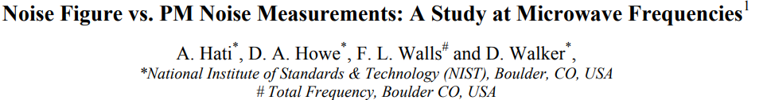
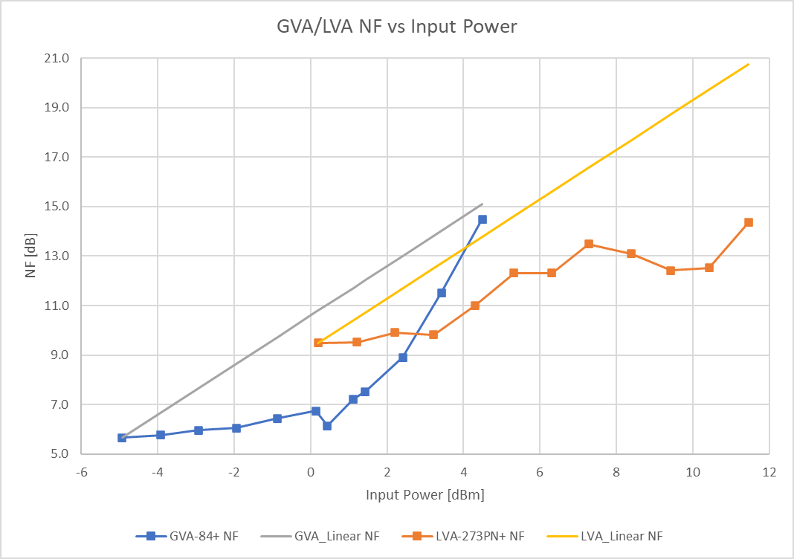
At 2 GHz Carrier
Key Equation!
L(f) [dBc/Hz]* = -177 [dBm/Hz] +NF(Pin) [dB] – Pin [dBm] [4]
(approximate for large signal.)
*White noise region
Parametric
Parametric
Additive
Additive

Slide 21
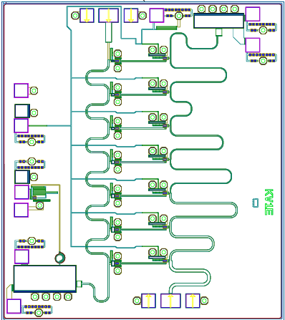
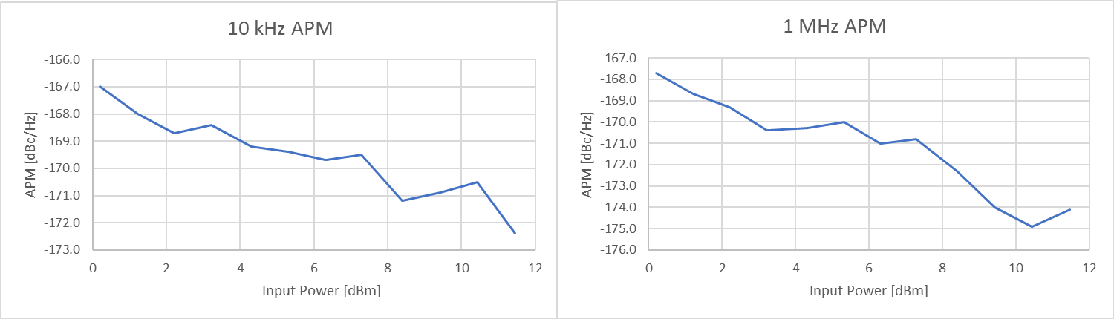
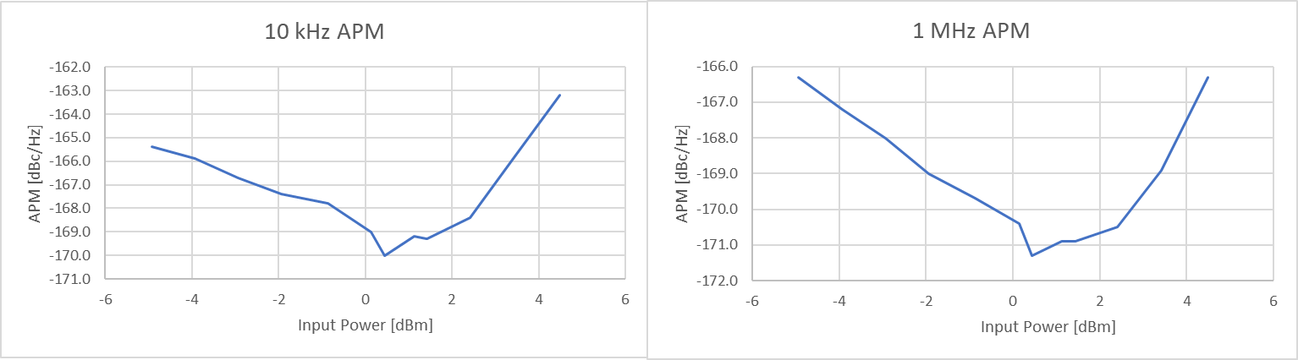
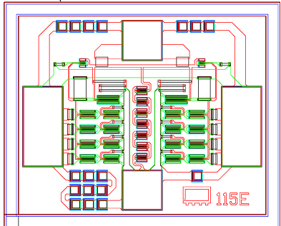
G = 17dB
NF = 8 dB
P1dB = +17 dBm
OIP3 = +27 dBm
Distributed*
*Hint: think parallel combining!
Mini-Circuits Proprietary
2 um InGaP/GaAs HBT
LVA-273PN+: 2 GHz Additive Phase Noise (APM) [dBc/Hz] at 10 kHz and 1 MHz offsets, versus Input Power [dBm]. (Pin_Opt = ~+11 dBm, Pin_1dB = ~+1 dBm).
G = 18dB
NF = 6 dB
P1dB = +21 dBm
OIP3 = +37 dBm
Darlington-Cascode
Mini-Circuits Proprietary
2 um InGaP/GaAs HBT
GVA-84+: 2 GHz Additive Phase Noise (APM) [dBc/Hz] at 10 kHz and 1 MHz offsets, versus Input Power [dBm]. (Pin_Opt = ~+1 dBm, Pin_1dB = ~+3 dBm).

Slide 22
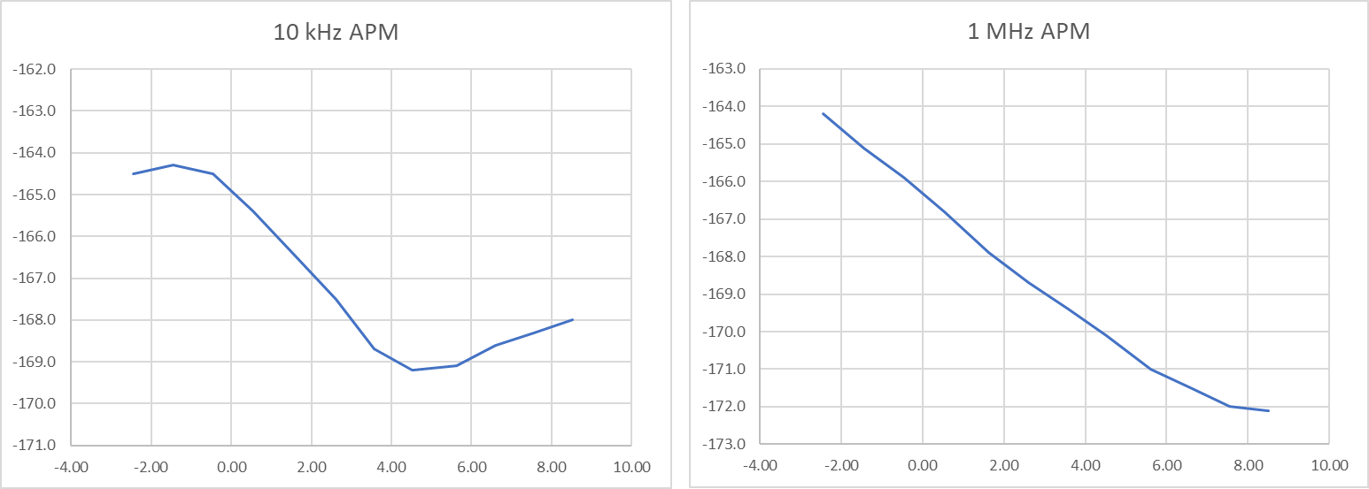
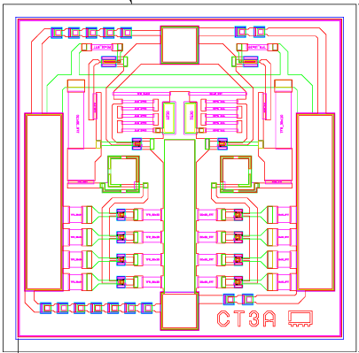
G = 15 dB
NF = 5 dB
P1dB = +20 dBm
OIP3 = +35 dBm
Darlington w/ Re feedback
Mini-Circuits Proprietary
2 um InGaP/GaAs HBT
GVA-62+: 2 GHz Additive Phase Noise (APM) [dBc/Hz] at 10 kHz and 1 MHz offsets, versus Input Power [dBm]. (Pin_Opt = ~+5 dBm, Pin_1dB = ~+6 dBm).
G = 18dB
NF = 6 dB
P1dB = +21 dBm
OIP3 = +37 dBm
Darlington Cascode
Mini-Circuits Proprietary
2 um InGaP/GaAs HBT
GVA-84+: 2 GHz Additive Phase Noise (APM) [dBc/Hz] at 10 kHz and 1 MHz offsets, versus Input Power [dBm]. (Pin_Opt = ~+1 dBm, Pin_1dB = ~+4 dBm).

Slide 23
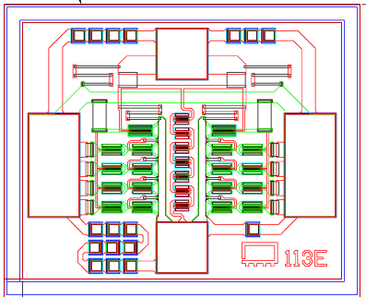
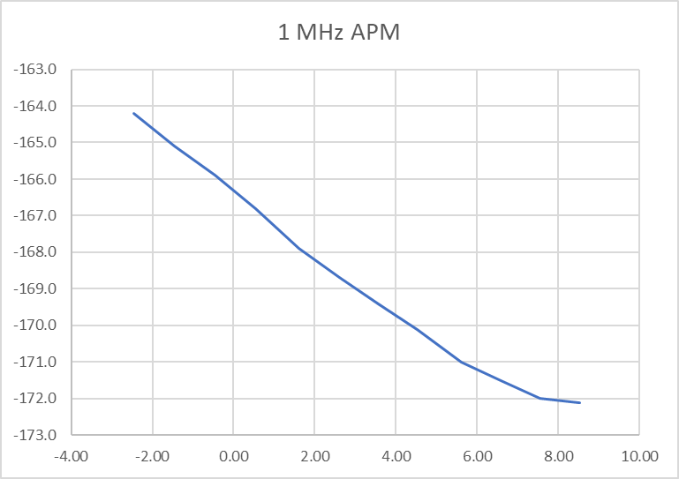
Effect of R_{_E} on APM
GVA-84+:
Idq=110 mA
Gdc=24 dB
P1dB=+21 dBm
NF=6 dB
2 um PWR InGaP/GaAs HBT
Darlington Cascode
R_{_E84}= ???
GVA-62+:
Idq=82 mA
Gdc=15 dB
P1dB=+20 dBm
NF=5 dB
2 um PWR InGaP/GaAs HBT
Darlington w/Re feedback
R_{_E62}= ???(> R_{_E84})
Fc=2 GHz
Mini-Circuits Proprietary
Mini-Circuits Proprietary
Fc=2 GHz

Slide 24
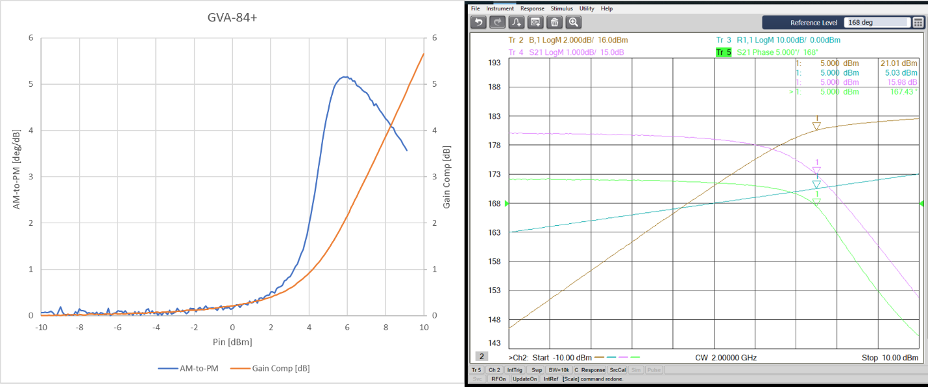
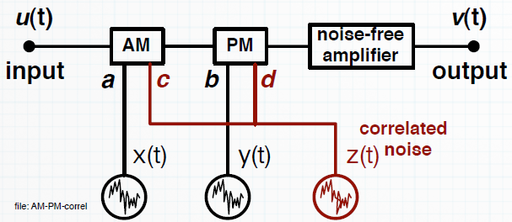
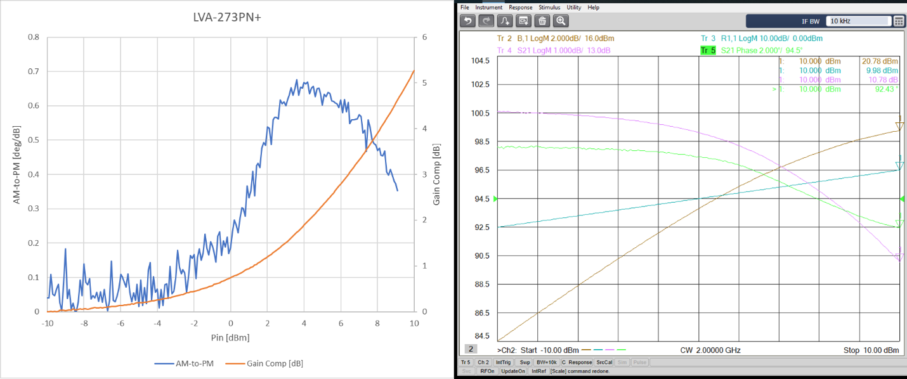
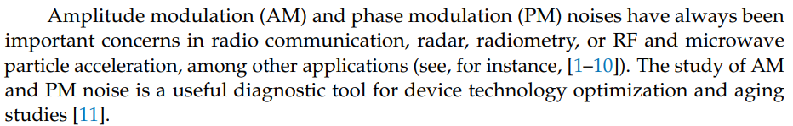
AM-to-PM Distortion
(Fc=2GHz)

Slide 25
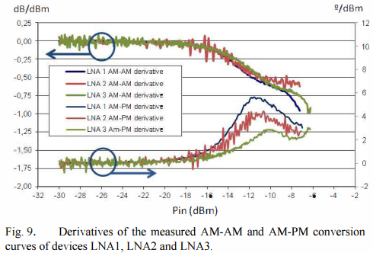
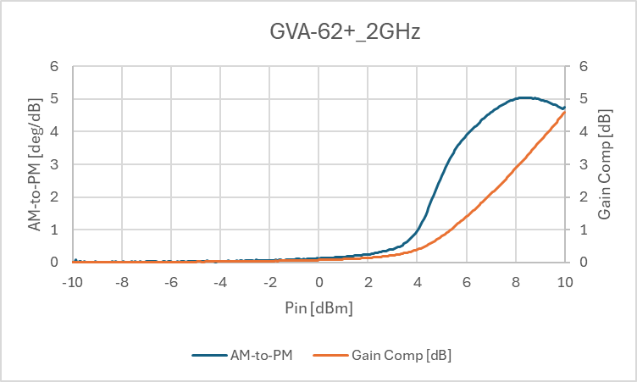
GVA-84+:
G = 18dB
NF = 6 dB
P1dB = +21 dBm
OIP3 = +37 dBm
Po_+1dBm=+19dBm
Darlington-Cascode
AM-to-PM Distortion
and
APM
(Fc=2GHz)
GOOD
LVA-273PN+:
G = 17dB
NF = 8 dB
P1dB = +17 dBm
OIP3 = +27 dBm
Po_+10dBm=+22dBm
Distributed
BEST
GVA-62+:
G = 15 dB
NF = 5 dB
P1dB = +20 dBm
OIP3 = +35 dBm
Po_+5dBm=+19.5dBm
Darlington w/Re feedback
Studies on small and large signal noise in Solid-State Amplifiers [7]
BETTER

Slide 26
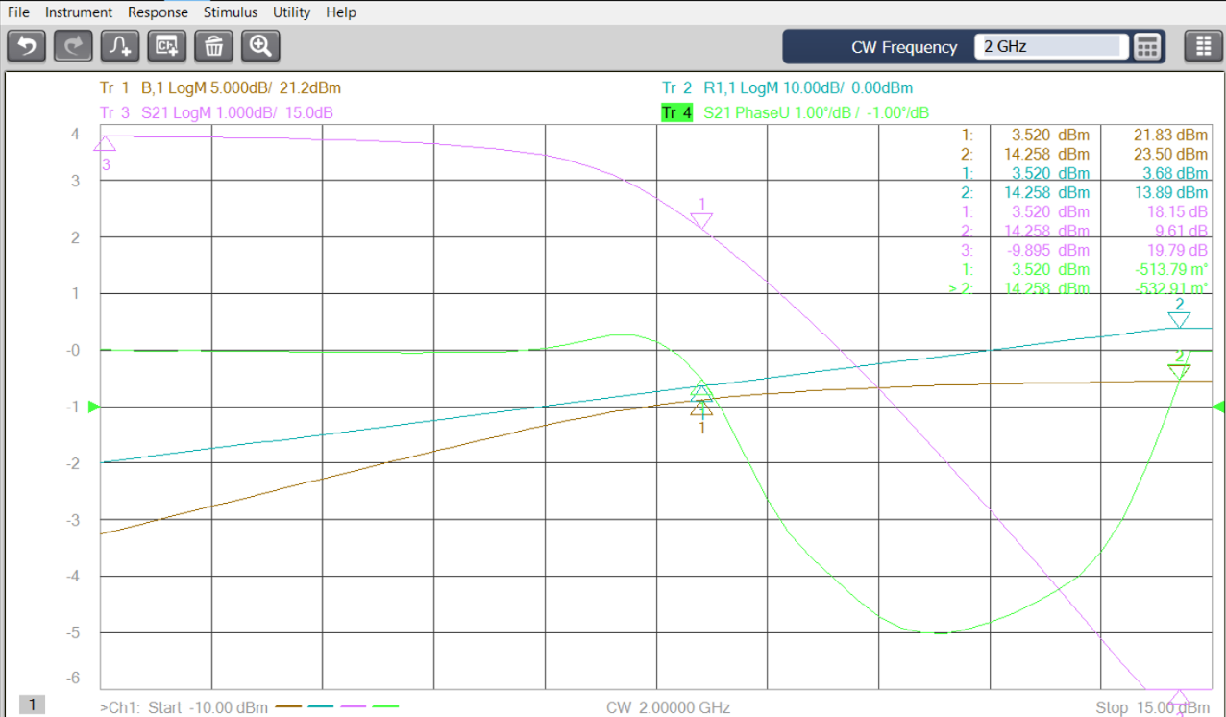
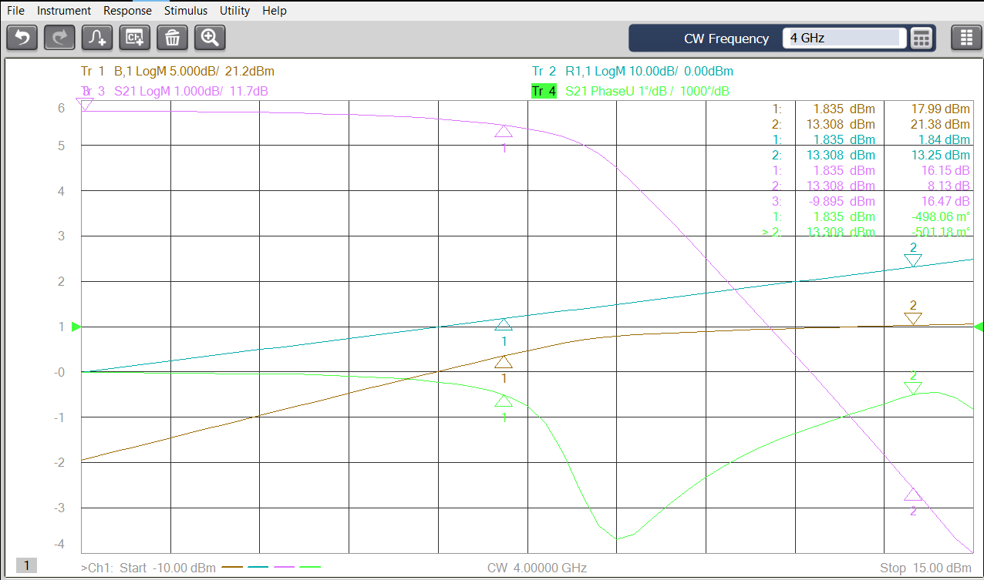
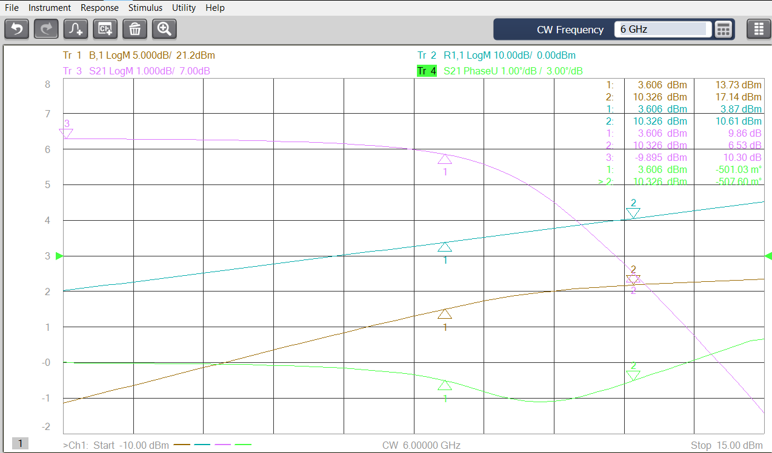






What happens with carrier frequency?
GVA-84+:
G = 18dB
NF = 6 dB
P1dB = +21 dBm
OIP3 = +37 dBm
Po_+1dBm=+19dBm
Darlington-Cascode
2GHz
4GHz
6GHz
-5deg/dB
-3.6deg/dB
-1.1deg/dB
LVA-273PN+:
G = 17dB
NF = 8 dB
P1dB = +17 dBm
OIP3 = +27 dBm
Po_+10dBm=+22dBm
Distributed
2GHz
4GHz
6GHz
-0.5deg/dB
-1deg/dB
-1.6deg/dB
GVA-62+:
G = 15 dB
NF = 5 dB
P1dB = +20 dBm
OIP3 = +35 dBm
Po_+5dBm=+19.5dBm
Darlington w/Re feedback
-5deg/dB
-3.4deg/dB
-1.3deg/dB

Slide 27

At different carrier frequencies
G_Compression
LVA-273PN+:
What happens with carrier frequency?
AM-to-PM Distortion

Slide 28

=>AM-to-PM Distortion
10 kHz Offset
L(f) [dBc/Hz] = -177 [dBm/Hz] +NF [dB] – Pin [dBm]
100 kHz Offset

Slide 29



G = 17 dB
NF = 5 dB
P1dB = +17 dBm
OIP3 = +27 dBm
Mini-Circuits Proprietary
2 um InGaP/GaAs HBT
AM-to-PM Distortion
Device Characterization Required
Mini-Circuits Proprietary
2 um InGaP/GaAs HBT
G = 19 dB
NF = 5 dB
P1dB = +20 dBm
OIP3 = +30 dBm
AM-to-PM Distortion
Device Characterization Required

Slide 30



Mini-Circuits Proprietary
AM-to-PM Distortion
Temperature Characterization Required
AM-to-PM Distortion

Slide 31


Is there anything we can do?
Additive Phase Noise
YELLOW: +6V
BLUE: +7V
GREEN: +8V
ORANGE: +9V
ALL Icc = 150mA@+5dBm
Pin = +5 dBm
Characterization over Operating Voltage Range may offer improvement in AM-to-PM and APN performance

Slide 32


Is there anything we can do?
Additive Phase Noise
YELLOW: +6V
BLUE: +7V
GREEN: +8V
ORANGE: +9V
ALL Icc = 150mA@+10dBm
Pin = +10 dBm
Characterization over Operating Voltage Range may offer improvement in AM-to-PM and APN performance

Slide 33
Amplifier Additive Phase Modulation Noise Characterization and Testing and Theoretical Discussion of White and Flicker Noise Processes in both Small and Large Signal Regions of Operation* Mini-Circuits
Low-Level Radio Frequency (LLRF) Workshop 2025
Part 1: What is it? How is it measured? How is it specified?
Part 2: Cascaded LO Drive Amplifiers
2-Series
4-Parallel
Part 3: Cascaded LO Drive Amplifiers
1-Series -> 4-Parallel
AM-to-PM Distortion Influence
Broadband and Cascade Design Tradeoffs
Id#107
*Class A, AB Only

Slide 34
+/-3dB*LOG₂(m)
*Hint: think Distributed!
PSD of Random Phase ф(t) = S_{ф} (f) = b₀ + b₋₁/f [rad^2/Hz] = FkTo/Pin + b₋₁/f [rad^2/Hz]
and L(f) [rad^2/Hz] = ½ S_{ф} (f) [rad^2/Hz]; L(f) [dBc/Hz] = 10*Log₁₀(S_{ф} (f)) - 3dB
Cascaded Devices Small Signal Operation
[2]

Slide 35




ZX60-223LPN+
(LVA-273PN+)
0 dB PAD
2G: NF=8.1,Gs=34dB
6G: NF=4.1,Gs=34dB
SS
SAT
Series Case 1: 6GHz
Amp1: 0 – 2dB Comp
Amp2: 5 – 13dB Comp

Slide 36


ZX60-223LPN+
6 dB PAD
2G: NF=8.4,Gs=28dB
6G: NF=4.3,Gs=28dB
SS
LS
Series Case 2: 6GHz
Amp1: 0 – 2dB Comp
Amp2: 2 – 7dB Comp

Slide 37





Series
Case: 2GHz
X1-0dB-X1 ZX60-233LPN+
X1-6dB-X1 ZX60-233LPN+
tj=9.8 fS,p-p
tj=10.0 fS,p-p
SS
Red: +5.5/+20.7dBm
Red: +5.5/+15dBm
SAT
SS
LS
Pout=+25.1dBm
Pout=+24.5dBm
Slope Eq.
Series
Case: 6GHz
X1-0dB-X1 ZX60-233LPN+
X1-6dB-X1 ZX60-233LPN+
tj=4.0 fS,p-p
tj=4.5 fS,p-p
Green: -0.89/+15.8dBm
Green: -0.89/+9.7dBm
SS
SAT
SS
LS
Pout=+24.4dBm
Pout=+22.8dBm

Slide 38



Series
Case: 2GHz
X1 ZX60-233LPN+
X1-6dB-X1 ZX60-233LPN+
tj=9.8 fS,p-p
tj=7.8 fS,p-p
SS
Red: +5.5dBm
SS
Red: +5.5/+15dBm
Pout=+20.7dBm
LS
Pout=+24.5dBm
Series
Case: 6GHz
X1 ZX60-233LPN+
X1-6dB-X1 ZX60-233LPN+
tj=4.0 fS,p-p
tj=3.3 fS,p-p
SS
Green: -0.89dBm
SS
Green: -0.89/+9.7dBm
LS
Pout=+15.8dBm
Pout=+22.8dBm

Slide 39


ZN4PD-02183-S+
X4 ZX60-223LPN+
ZN4PD-02183-S+
LS
Parallel Case 1: 6GHz
X4 Amp1: 1 – 3dB Comp

Slide 40


Parallel
Case: 2GHz
X1 ZX60-233LPN+
X4 ZX60-233LPN+
tj=7.8 fS,p-p
Red: +4.9dBm
SS
Red: +5.5dBm
LS
Noise Floor Limited
Pout=+20.7dBm
Pout=+26.2dBm
Parallel
Case: 6GHz
X1 ZX60-233LPN+
X4 ZX60-233LPN+
tj=3.3 fS,p-p
Red: +3.8dBm
SS
Gray: +3.1dBm
LS
Noise Floor Limited
Pout=+19.0dBm
Pout=+25.0dBm

Slide 41
Amplifier Additive Phase Modulation Noise Characterization and Testing and Theoretical Discussion of White and Flicker Noise Processes in both Small and Large Signal Regions of Operation* Mini-Circuits
Low-Level Radio Frequency (LLRF) Workshop 2025
Part 1: What is it? How is it measured? How is it specified?
Part 2: Cascaded LO Drive Amplifiers
2-Series
4-Parallel
Part 3: Cascaded LO Drive Amplifiers
1-Series -> 4-Parallel
AM-to-PM Distortion Influence
Broadband and Cascade Design Tradeoffs
Id#107
*Class A, AB Only

Slide 42


X1 ZX60-223LPN+
0 dB PAD
ZN4PD-02183-S+
X4 ZX60-223LPN+
ZN4PD-02183-S+
2G: NF=8.1,Gs=33dB
6G: NF=4.1,Gs=33dB
LS
SAT
Series/Parallel Case 1: 6GHz
X1 Amp1 (A1) – X4 Amp1 (A2)
X1:1 – 5dB Comp. X4(each): 5 – 10dB Comp

Slide 43

X1 ZX60-223LPN+
8 dB PAD
ZN4PD-02183-S+
X4 ZX60-223LPN+
ZN4PD-02183-S+
2G: NF=8.5,Gs=25dB
6G: NF=4.6,Gs=25dB
SS
SS
Series/Parallel Case 2: 6GHz
X1 Amp1 – X4 Amp1
X1:1 – 2dB Comp. X4(each): 1 – 2dB Comp

Slide 44


6GHz
X1 ZX60-223LPN+
0 dB PAD
ZN4PD-02183-S+
X4 ZX60-223LPN+
ZN4PD-02183-S+
tj=4.5 fS,p-p
X1 - 0dB - X4 ZX60-233LPN+
(A1: large signal. A2: SAT)
tj=3.15 fS,p-p
X1 - 8dB – X4 ZX60-233LPN+
(A1:small signal
A2: small signal)
Red: +10.6/+16.8dBm
Blue: +0.4/+10.2dBm
Red: +4.5/+5.8dBm
LS
Pout=+30.2dBm
Pout=+28.6dBm
X1 ZX60-223LPN+
8 dB PAD
ZN4PD-02183-S+
X4 ZX60-223LPN+
ZN4PD-02183-S+
SS
SAT
SS
Pout=+26.1dBm
6G: NFs=4.1,Gs=33dB
6G: NF_{L}=10.4,G_{L}=28dB
Standard Cascade vs Additive Phase Noise Design (1/f!)
6G: NFs=4.1,Gs=33dB
6G: NF_{L}=20.6,G_{L}=19.6dB
6G: NFs=4.6,Gs=25dB
6G: NF_{L}=11.5,G_{L}=22dB
“Best” Pin

Slide 45
Series Case: 6GHz
tj=4.5 fS,p-p
X1 - 0dB - X4 ZX60-233LPN+
(A1: large signal. A2: SAT)
tj=3.15 fS,p-p
X1 - 8dB – X4 ZX60-233LPN+
(A1:small signal
A2: small signal)
Red: +10.6/+16.8dBm
Red: +4.5/+5.8dBm
LS
SAT
SS
SS
Pout=+30.2dBm
Pout=+26.1dBm
Series Case: 6GHz
X1 – 8dB-X4 ZX60-233LPN+
X1-6dB-X1 ZX60-233LPN+
tj=3.15 fS,p-p
tj=4.0 fS,p-p
Red: +4.5/+5.8dBm
SS
SS
SS
Green: -0.89/+9.7dBm
Pout=+26.1dBm
LS
Pout=+22.8dBm

Slide 46

Series
Case: 2GHz
X1 – 0dB-X4 ZX60-233LPN+
X1-0dB-X1 ZX60-233LPN+
tj=7.5 fS,p-p
Red: +11.1/+17.3dBm
tj=10.0 fS,p-p
Red: +5.5/+20.7dBm
LS
SAT
SS
Pout=+25.1dBm
Pout=+31.4dBm
SAT
Series
Case: 2GHz
X1 – 0dB-X4 ZX60-233LPN+
X1-6dB-X1 ZX60-233LPN+
tj=7.5 fS,p-p
Red: +11.1/+17.3dBm
tj=9.8 fS,p-p
Red: +5.5/+15dBm
LS
SAT
SS
LS
Pout=+31.4dBm
Pout=+24.5dBm

Slide 47
Low-Level Radio Frequency (LLRF) Workshop 2025
References
[1] “Microwave and Wireless Synthesizers, Theory and Design, 2nd Edition”, Ulrich L. Rohde, Enrico Rubiola, Jerry C. Whitaker, 2021 John Wiley & Sons, Inc. Published 2021 by John Wiley & Sons, Inc.
[2] “Phase Noise in RF and Microwave Amplifiers”, Rodolphe Boudot and Enrico Rubiola, IEEE Transactions on Ultrasonics, Ferroelectrics and Frequency Control, Vol. 59, No. 12, December 2012.
[3] “A Study of the Correlation Between High-Frequency Noise and Phase Noise in Low-Noise Silicon-Based Transistors”, Gilles Cibiel, Laurent Escotte and Oliver Llopis, IEEE Transactions on Microwave Theory and Techniques, Vol. 52, No. 1, January 2004.
[4] “Noise Figure vs. PM Noise Measurements: A Study at Microwave Frequencies”, A. Hati, D. A. Howe, F. L. Walls and D. Walker, Proceedings of the 2003 IEEE International Frequency Control Symposium and PDA Exhibition Jointly with the 17th European Frequency and Time Forum.
[5] “Additive Phase Noise in Linear and High-Efficiency X-Band Power Amplifiers”, Jason Breitbarth, Srdjan Pajic’, Narisi Wang and Zoya Popovic’, University of Colorado, Boulder, CO.
[6] “Study of PM Noise and Noise Figure in Low Noise Amplifiers Working under Small and Large Signal Conditions”, N. Garmendia, J. Portilla, Member, IEEE Electricity and Electronics Department, University of the Basque Country, Apdo. 644, 48080 Bilbao, Spain.
[7] “Studies on small- and large-signal noise in Solid-State Amplifiers”, J. Portilla and R. Jauregui Department of Electricity and Electronics University of the Basque Country, UPV/EHU Barrio Sarriena sin, 48940, Leioa, Spain joaquin.portilla@ehu.es; Rigoberto jauregui@ehu.es. N. Garmendia RF group ESS-Bilbao Ed. Cosimet, Landabarri, 2, 48940 Leioa, Spain ngarmendia@essbilbao.org.
[8] “Effect of the Input and Output Impedance on Amplifier Large-Signal Noise Performances”, Nagore Garmendia and Joaquín Portilla, Member, IEEE, IEEE TRANSACTIONS ON MICROWAVE THEORY AND TECHNIQUES, VOL. 59, NO. 6, JUNE 2011.
[9] “A collapse of the cross-spectral function in phase noise metrology”, C.W. Nelson, A. Hati and A. Howe, National Institute of Standards and Technology.
[10] “1/f Noise in Proton Irradiated SiGe HBTs”, Zhenrong Jin, Guofu Niu, John D. Cressler, Cheryl J. Marshall, Paul W. Marshall, Hak S. Kim, Robert Reed, and David L. Harame, Auburn University, NASA GSFC, Consultant, Jackson and Tull Chartered Engineers, IBM Microelectronics.
[11] “Flicker noise in AlGaAs/GaAs of high electron mobility heterostructure field-effect transistor at cryogenic temperature”, Souheil Mouetsi^{1,2}, Foudil Zouach¹ and Djamil Rechem^{1,2} . ¹ Department of electrical engineering, faculty of sciences and applied sciences, University Larbi Ben M’hidi,Oum El Bouaghi, Algeria. ² Laboratory of active components and materials, University Larbi Ben M’hidi, Oum El Bouaghi. Algeria
Amplifier Additive Phase Modulation Noise Characterization and Testing and Theoretical Discussion of White and Flicker Noise Processes in both Small and Large Signal Regions of Operation* Mini-Circuits
*Class A, AB Only
Id#107

Slide 48
Low-Level Radio Frequency (LLRF) Workshop 2025
Amplifier Additive Phase Modulation Noise Characterization and Testing and Theoretical Discussion of White and Flicker Noise Processes in both Small and Large Signal Regions of Operation* Mini-Circuits
Understanding Additive Phase Noise in RF & Microwave Amplifiers - Part 1
https://m.youtube.com/watch?v=s09qfKjMLqo
Understanding Additive Phase Noise in RF & Microwave Amplifiers - Part 2
https://m.youtube.com/watch?v=ZWP0-BcWarc&feature=youtu.be
Understanding Additive Phase Noise in RF & Microwave Amplifiers - Part 3
https://www.youtube.com/watch?v=MK6iualRipM
Id#107
*Class A, AB Only

